Slide 1
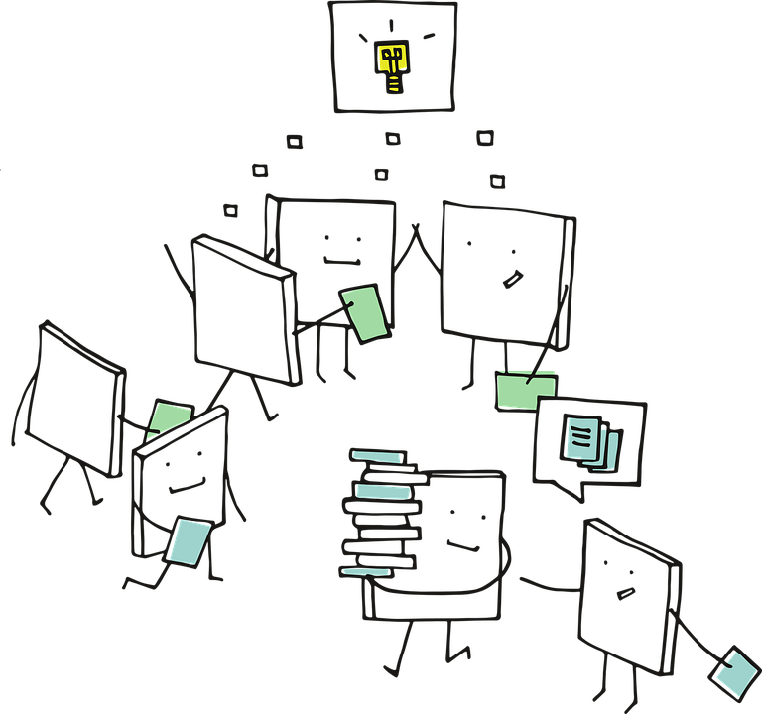
CNN - II

Slide 2
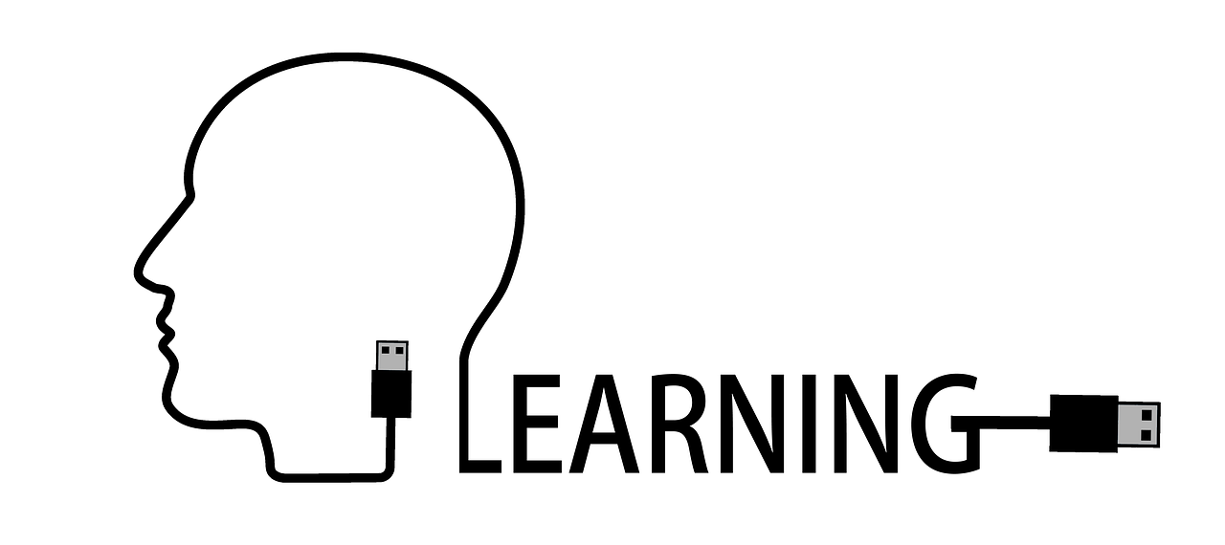
Transfer
Learning

Slide 3
What is Transfer Learning?
Reuse existing knowledge for new task
For example, it’s easier to pick-up Tennis once you know Badminton
Humans excel at Transfer Learning
Reduces resources and training time to do new task!

Slide 4

What are the constraints in building Deep Learning models?

Slide 5
Problems with building Deep Learning models?
Need large amount of labeled data (huge resources)
Longer training time
Can transfer Learning help here?

Slide 6
What does Transfer Learning mean in Deep Learning?
Re-use existing knowledge (architectures, weights) from a trained ML model on a New task

Slide 7
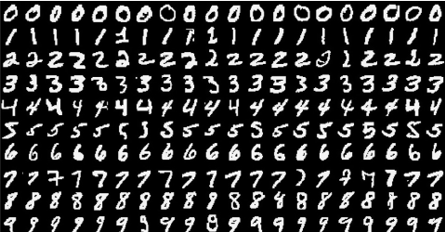
Suppose we have trained a Classifier (Model#1) on 5 handwritten digits (0-4)
Transfer Learning Scenario

Slide 8
Can we use knowledge from Model#1to build another model which can classify digits 5 to 9
Scenario 1 : Similar Domain, Different Task
Transfer Learning

Slide 9
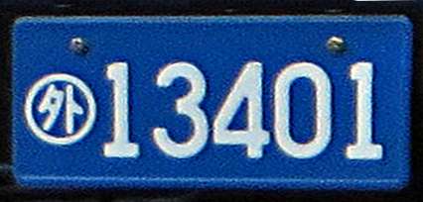
Can we use knowledge from Model#1to build another model which can classify digits 0 to 4 in a ‘number plate’
Scenario 2 : Different Domain, Same Task
Transfer Learning

Slide 10
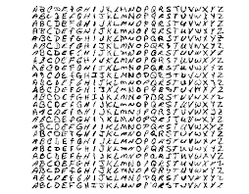
Can we use knowledge from Model#1to build another model which can classify Alphabets
Scenario 3 : Different Domain, Different Task
Transfer Learning

Slide 11
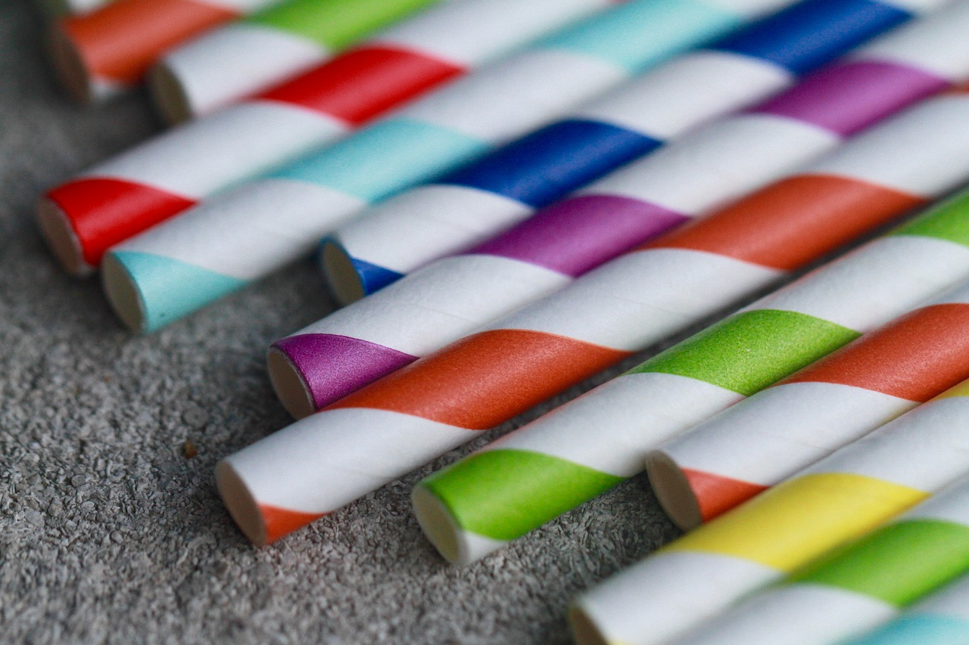
Applications of
Transfer Learning

Slide 12
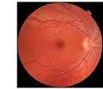
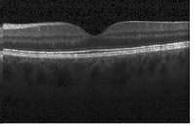
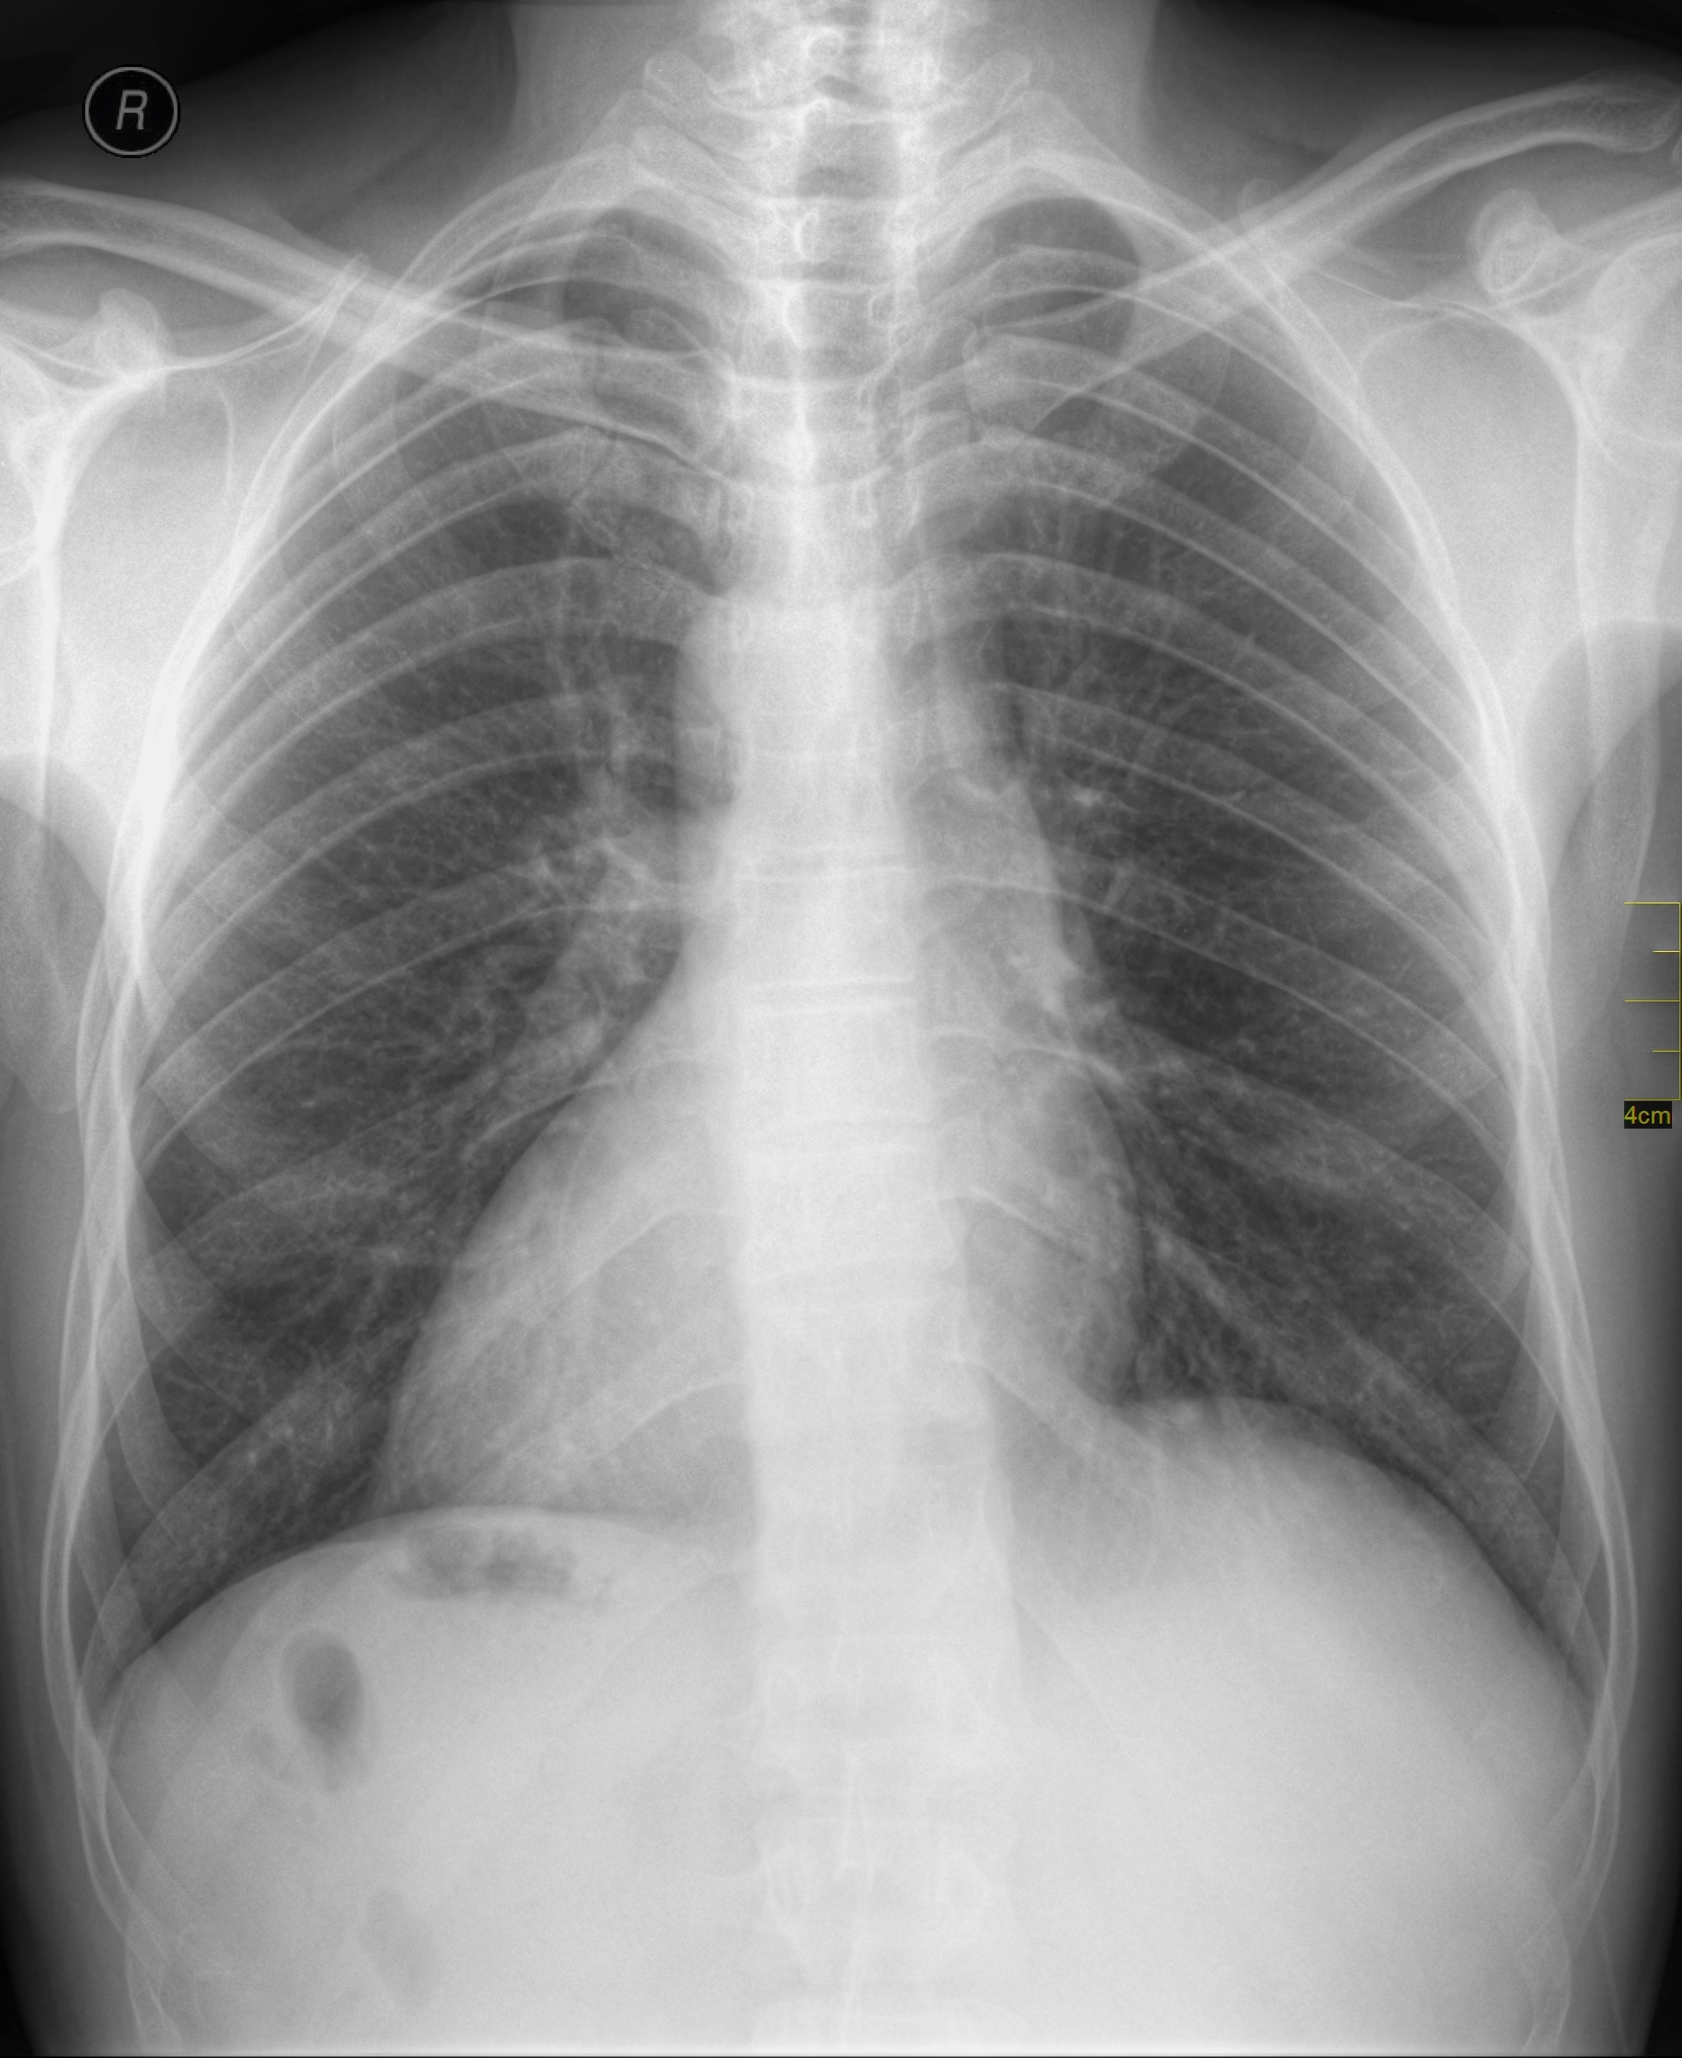
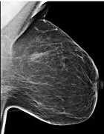
Classifying Medical images
e.g Disease Identification
Labeled Data is hard to get and very expensive
We can reuse VGG trained on ImageNet to classify Medical images

Slide 13
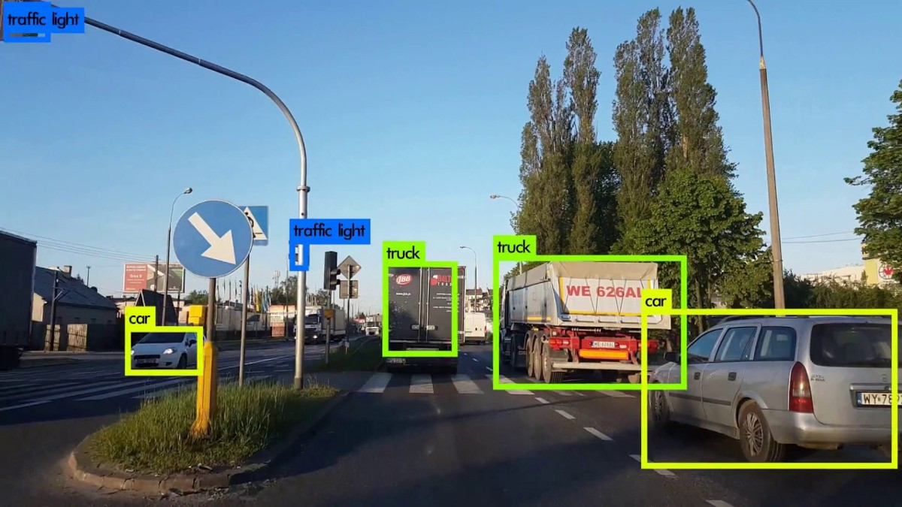
Object Detection
Labeling data with bounding boxes is even harder and expensive
We can reuse Inception Model trained on ImageNet to classify and identify bounding boxes around objects

Slide 14
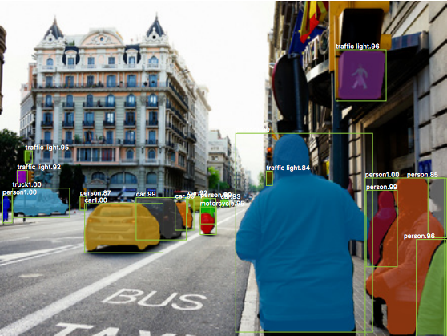
Image Segmentation
Much harder to build data as each Pixel needs to be annotated
We can reuse ResNet Model trained on ImageNet to classify each pixel for Segmentation

Slide 15

How to implement
Transfer Learning?

Slide 16
Image Data
Conv + Pooling Layers
Conv + Pooling Layers
Conv + Pooling Layers
Classifier
Layers (Dense)
Class Probabilities
Let’s consider a common CNN Architecture for Classification

Slide 17
Image Data
Conv + Pooling Layers
Conv + Pooling Layers
Conv + Pooling Layers
Classifier
Layers (Dense)
Class Probabilities
Features extractor
Convolutional layers act as Feature extractor while Dense Layer is used to classify image (using features extracted by Conv Layers)
Role of Conv Layers

Slide 18
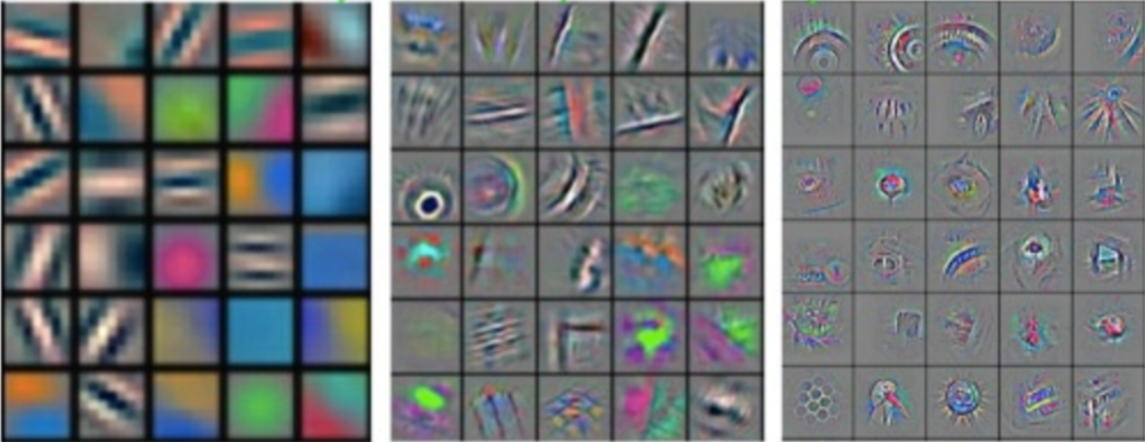
Image Data
Conv + Pooling Layers
Conv + Pooling Layers
Conv + Pooling Layers
Classifier
Layers (Dense)
Class Probabilities
Low Level Features
Mid Level Features
High level features
Source: Feature Visualization of Convnet trained on ImageNet from [Zeiler & Fergus 2013]
Different Conv layers learn different features, later Conv Layers combine features from earlier layers

Slide 19
Image Data
Conv + Pooling Layers
Conv + Pooling Layers
Conv + Pooling Layers
Classifier
Layers (Dense)
Class Probabilities
Low Level Features
Mid Level Features
High level features
Low Level Features: Likely reusable across different domains
High Level Features: Specific to domain, less reusable across different domains
Source: Feature Visualization of Convnet trained on ImageNet from [Zeiler & Fergus 2013]
Different Conv layers learn different features, later Conv Layers combine features from earlier layers

Slide 20
Image Data
Conv + Pooling Layers
Conv + Pooling Layers
Conv + Pooling Layers
Classifier
Layers (Dense)
Class Probabilities
How do we use a Model trained on lots of data (like ImageNet) on a New task?

Slide 21
New task Data
Conv + Pooling Layers
Conv + Pooling Layers
Conv + Pooling Layers
Classifier
Layers (Dense)
Class Probabilities
Freeze Layers
NEW Classifier
Layers (Dense)
Class Probabilities for NEW task
Features
Using Pre-Trained Model on New Task
Transfer Learning

Slide 22
Input
Conv 3x3, 64
Conv 3x3, 64
Pool
Conv 3x3, 128
Conv 3x3, 128
Pool
Conv 3x3, 256
Conv 3x3, 256
Pool
Conv 3x3, 512
Conv 3x3, 512
Conv 3x3, 512
Conv 3x3, 512
Pool 3x3
Conv 3x3, 512
Conv 3x3, 512
Conv 3x3, 512
Conv 3x3, 512
Pool 3x3
FC 4096
FC 4096
FC 1000
SoftMax
Frozen
Retrained
VGGNet for Transfer Learning

Slide 23
Should we freeze All Convolutional Layers?
Not necessarily, it will vary with different scenarios!

Slide 24
Transfer Learning Strategy
Similar to Pre-Trained Model
Different from Pre-trained Model
Freeze All Convolutional Layers | Freeze all except last few Convolutional Layers
Freeze all except last few Convolutional Layers | Train entire Model (No Conv layer to be Frozen)
Small Dataset
Large Dataset

Slide 25
Summary
Use Architecture, Weights from Pre-Trained networks
Extract features from Conv Layers, train a classifier
Reduce data need and training time
Retrain few or all Conv layers depending upon similarity and size of available data

